Slide 1



Group 7
Data Analysis
using MATLAB

Slide 2

Overview
Introduction
Background
Methodology
Simulation
Algorithm
Result
Conclusion

Slide 3

Introduction
This project focuses on analyzing pricing trends of various product models and predicting the price of a new model using a linear regression model. This approach helps in identifying pricing patterns across different models and forecasting future prices based on historical data.
We will use a dataset that includes product models and their corresponding prices, apply regression techniques, and visualize the pricing trends for better insights.

Slide 4

Background
We have conceptualized a project on the basis of Linear Regression Model.
Linear regression is a common statistical method for examining the relationship between a dependent variable (price) and one or more independent variables (product versions). We have applied this to visualize the trends in pricing.

Slide 5
Methodology
Methodology
Linear Regression model
1
Data Collection
2
3
Model Development
Data preprocessing
4
Read and stored data
4
Prediction of new model price
Price Analysis and Visualization
5

Slide 6
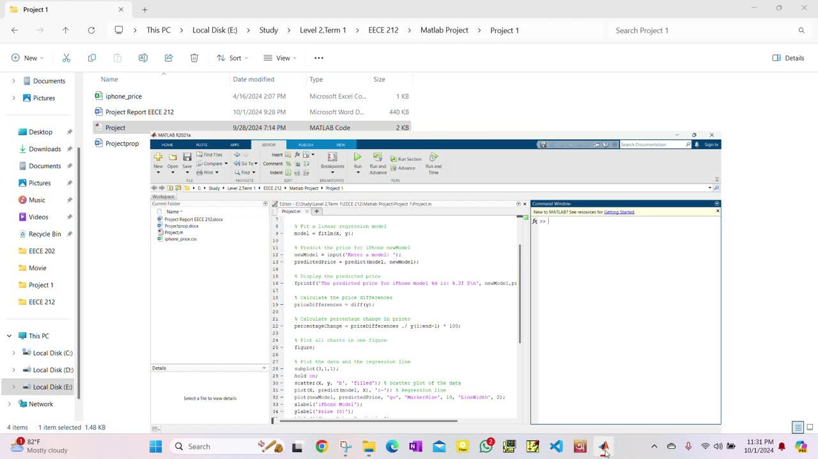
Simulation

Slide 7
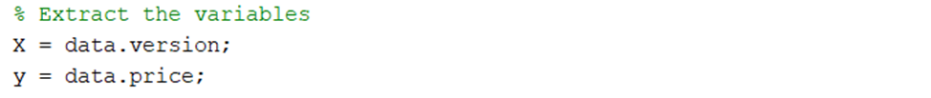
Algorithm
Step 1: Loading the Dataset
Step 2: Extracting Variables

Slide 8
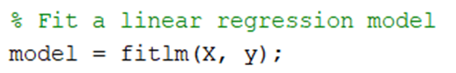
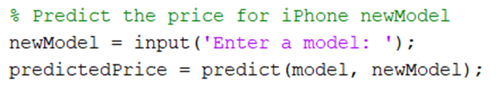
Algorithm cont.
Step 3: Fitting Linear Regression Model
Step 4: Predicting the Price for a New iPhone Model

Slide 9
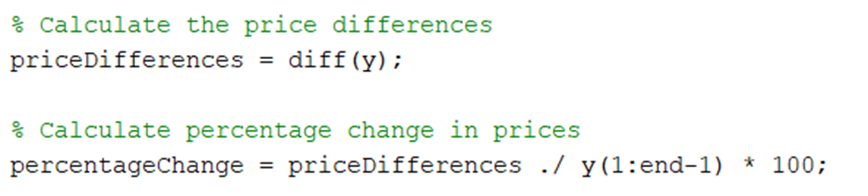
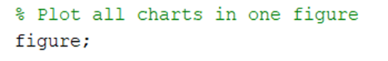
Algorithm cont.
Step 5: Displaying the predicted price
Step 6: Calculating Price Differences and Percentage Changes
Step 7: Plotting the Data

Slide 10
Algorithm cont.
Subplots plotted under figure constitute of the plots of:
Data and Regression Line
Price Differences
Percentage Change in Prices
By the use of these sub plots bar charts and scatter plots of our analyzed data were simulated

Slide 11
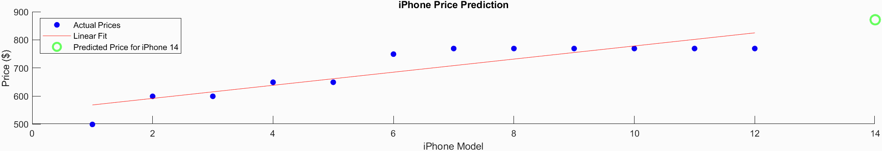
Result
For IPhone Price Prediction
The scatter plot with the linear regression line shows how well the linear model fits the price trend.

Slide 12
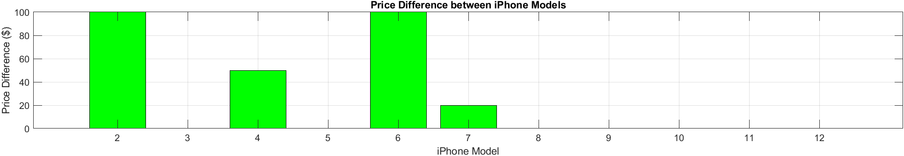
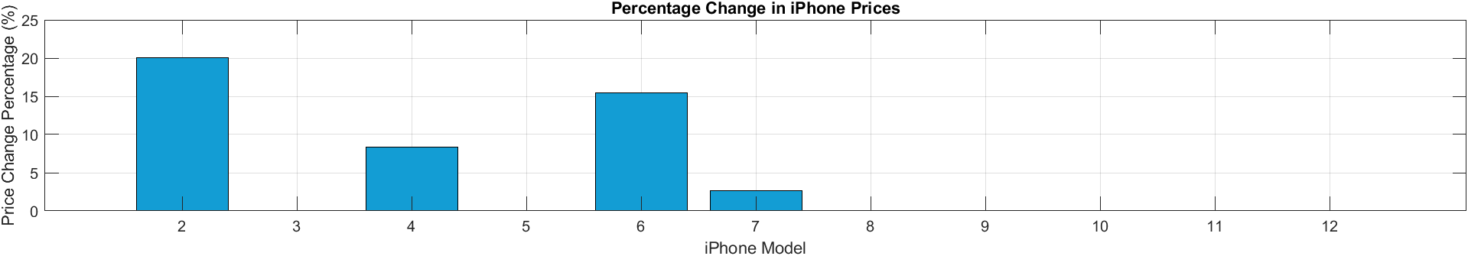
Result
Cont.
Price Difference between IPhone Models
Percentage Change in IPhone Prices

Slide 13
Conclusion
The project showcased the use of linear regression to predict product prices based on historical data, revealing price trends over time.
While the model offers valuable forecasts, it assumes a linear relationship, which may not always apply. Future work could explore more advanced models for improved accuracy.

Slide 14


Thank
You

